Slide 1
Module 3: SSIS Development

Slide 3
Agenda
Project vs Package
Connection Manager
Variables vs Parameters
Expressions
Connection Strings
Control Flow
Precedence Constraints
Data Flow
Event Handlers
Control Flow Parts

Slide 4
Project vs Package
Projects Contains
One or more packages
Project Parameters
Connection managers (shared connections)
Control flow parts
Package Contains
Control Flow
Data Flow
Package Parameters
Event Handlers
Connection manager (dedicated).

Slide 5
Projects vs Packages
Demo
Notes:
Demo: Module 03: Projects vs Packages

Slide 6
Projects vs Packages
Lab

Slide 7
Connection Manager
Allows SSIS to connect to any number of sources for both input and output.
There are built in drivers such as OleDB, Flat File, ADO.NET, Analysis Service, etc.
Additional connections drives such as Odata, Hadoop, and Azure has been added in SQL Server 2016+.
Connections defined in connection manger are used for Control Flow, Data Flow, and Log Providers.

Slide 8
Connection Manager (2)
Following connection managers are only available in Control Flow.
FTP, HTTP, MSMQ, SMOServer, SMTP, and WMI

Slide 9
Connection Manager (3)
Following connection managers are available to both Source and Destination data flows:
Database (ADO.NET, OLE DB, or CDC Source) or File (Excel, Flat File, XML, Raw File).
Following connection managers are available only to Destination data flows:
SSAS (Data mining model training, Dimension processing, or partition processing) or Rowset (Data reader, Recordset).

Slide 10
Connection Manager
Demo
Notes:
Demo: Module 03: Connection Manager

Slide 11
Variables vs Parameters
Variables
Are package level only.
Are read-write.
Parameters
Are package or project level.
Cannot be modified directly but can be updated as a pass-through value.
Are type of variable.

Slide 12
Variables vs Parameters – Supported Data Types
Variables
Types available:
All the types of parameters.
Plus Char, DBNULL, Objects.
Parameters
Types available:
Boolean, Byte, DateTime, Decimal, Double, Int16, Int32, Int64, Sbyte, Single, String, UInt32, and UInt64.

Slide 13
Variables vs Parameters – Scope
Variables
Defined at development, can be granular at task level.
Can change of the variable in design time only.
Scope: Package Level, Container Level, Data Flow, and Task Level.
Visible as User::VariableName
Parameters
Project Level – Visible to all Packages.
Visible as $Project::ParameterName
Package Level – Visible to package defined in.
Visible as $Package::ParameterName

Slide 14
Variables vs Parameters – System
Variables
System variable available for Projects, Packages, Tasks, etc. and are read-only.
Visible as System::VariableName
Not all system variables are not visible in all locations (e.g. System::ErrorCode and System::ErrorDescription are only visible in OnError event handler).
Parameters
No system parameters.

Slide 15
Variables vs Parameters – Additional Information
Variables
Some variables need to be saved in the database to allow for persistence (e.g. CDC Control Task).
Parameters
Order of precedence for value assigned to parameter is Execution > Server > Design.
Has additional properties on sensitive and required.

Slide 16
Parameters
Lab

Slide 17
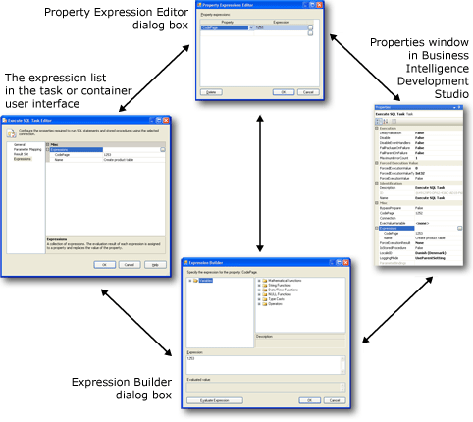
Expressions
Used to dynamic assignment or comparison, instead of hard-coding values.
Expression syntax is similar to C# Style
Value Assignment uses single equal (=)
Equality Comparison uses double equal (==)
Precedence Constraint, Conditional Split Transform
Data Type Casting : (data_type_to_cast_to) value
Variable referenced as @[NameSpace::VariableName] eg: @[User::MyCounter]
Notes:
https://docs.microsoft.com/en-us/sql/integration-services/expressions/use-property-expressions-in-packages?view=sql-server-2017

Slide 18
Expressions – Additional Info
Expression Builder GUI – Lists functions & function input parameters
New SQL 2012+ expression functions – LEFT, REPLACENULL, TOKEN, TOKENCOUNT
Removal of 4000 character limit for expressions, in SQL 2012+.

Slide 19
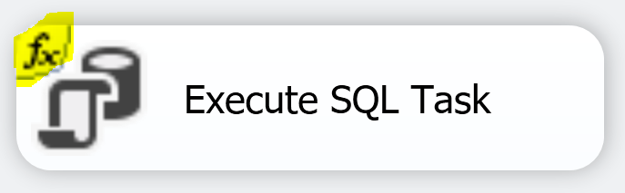
Property Expressions
Dynamically update task property at run time.
Any task or object that has expressions has “fx” added to the object to signal it is using expressions.
Can be set for:
Package, Task, Foreach Loop, For Loop, Sequence, Foreach enumerator, Event Handler, A package or project level connection manager, or Log Provider.

Slide 20
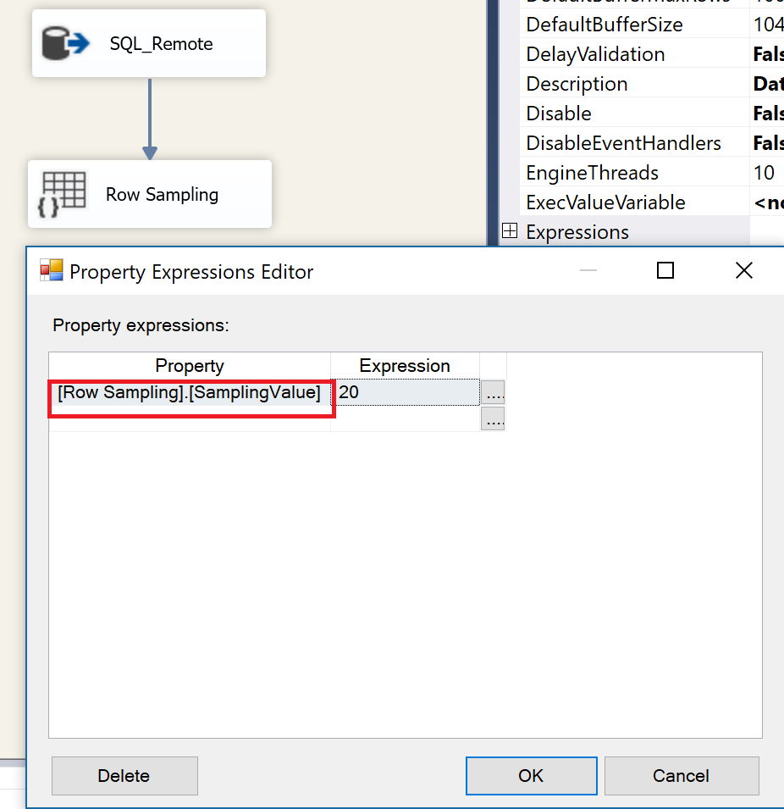
Property Expressions – Data Flow
Data Flow expressions are not straight forward. To set the expression, you must set the expression at Data Flow Task in Control Flow.
Expressions are not available for all data flow tasks.
Notes:
You will not be able set the expression by selecting the Source, Transform or the Destination.
You need to click on the canvas area or select the Data Flow Task from the Control tab in Visual Studio and then set the expressions that way.
https://msdn.microsoft.com/en-us/library/ms136104.aspx

Slide 21
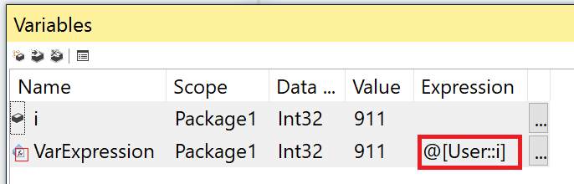
Variable Expressions
Assigns value to variable.
Dynamically update variable value property at run time.
Expression markers.

Slide 22
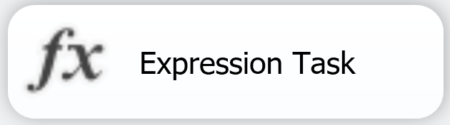
Expression Task
Assigns value to only one variable.
Introduced in SQL Server 2012+.
Not available in Data Flow Task.

Slide 23
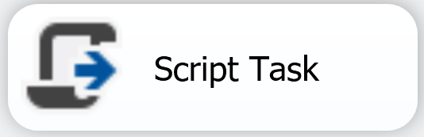
Control Flow Script Task
Can also be use to assigns value to variable(s).
.NET script can be used to assign values
Example: Dts.Variables["User::MyIntVar"].Value =911

Slide 24
Expression Task vs Script Task Variable Assignment
Expression Task
Only one value assignment
Quicker to modify
Script Task
Multiple value assignment possible.
A bit longer to modify, VSTA (VSTA need to be loaded each time to modify).

Slide 25
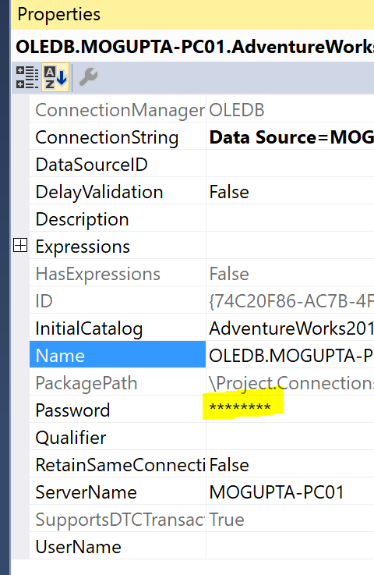
Sensitive Data
Sensitive SSIS properties
Password for connection string
Not all properties are sensitive, for example, we might want to protection Username also.
Workaround is promote the parameter for username to sensitive.
Notes:
Reference: https://docs.microsoft.com/en-ca/sql/integration-services/security/access-control-for-sensitive-data-in-packages

Slide 26
Variables & Expressions
Demo
Notes:
Demo: Module 03: Variables, Expressions & Parameters

Slide 27
Connection Strings
Defines how to connect to data source.
Provides all the important information, for example, for connecting to SQL Server:
Server Name
Instance Name
Port
Authentication Type (Trusted vs User Name / Password)
Database Name
Notes:
Handy tool for getting connection strings: http://www.connectionstrings.com

Slide 28
Connection Strings - Security
Deploy packages to SSISDB Catalog
Catalog automatically encrypts/decrypts based on Sensitive property.
Username is not sensitive
Workaround promote to property to parameter, and set parameter as sensitive.
Password is sensitive

Slide 29
Connecting String – Security (2)
Package Protection Level
How to store sensitive values in file content
Set Project and all Package ProtectionLevel to be same.
Package Protection Level | Notes
DontSaveSensitive | Sensitive data is not saved in package. Must supply on execution via parameters.
EncryptSensitiveWithPassword | Password used to encrypt entire package content. To run or open in SSDT, must supply password.
EncryptSensitiveWithUserKey (default) | Uses current user profile to encrypt only sensitive values. Only same users can open package in SSDT. If different user opens in SSDT, must re-supply sensitive values.
EncryptAllWithPassword | Encrypt all values, not just sensitive with password.
EncryptAllWithUserKey | Encrypt all values, not just sensitive with current user profile.
Notes:
Reference: https://docs.microsoft.com/en-ca/sql/integration-services/security/access-control-for-sensitive-data-in-packages

Slide 30
Connecting String – Security (3)
Package Protection Level | Notes
ServerStorage (does not show in dropdown) | Used by SSISDB catalog, SQL 2012+ Catalog automatically encrypts the package data and sensitive values. Projects Exported from catalog automatically set to EncryptSensitiveWithUserKey With each project deployment creates Certifcate - MS_Cert_Proj_<Project_ID> Symmetric Key - MS_Enckey_Proj_<Project_ID> which is used to encrypt the project. First project execution creates Certifcate - MS_Cert_Proj_Param_<Project_ID> Symmetric Key - MS_Enckey_Proj_Param_<Project_ID> which is used to encrypt the project parameter values.
Notes:
Reference: https://docs.microsoft.com/en-ca/sql/integration-services/security/access-control-for-sensitive-data-in-packages

Slide 31
Connection String
Lab

